Slide 1
Digital Footprint
Oops! I Broadcast it on the Internet

Slide 2
Did you know…?
There are benefits to sharing information online, but the Internet should generally be considered public because:
  (1) “private” information can become public if passed on
  (2) posts in many online communities are public by default.

Slide 3
Did you know…?
Most information posted online:
  (1) can be searched
  (2) can be seen by HUGE, invisible audiences
  (3) can be copied, altered, and sent to others
  (4) is persistent – it’s almost impossible to take down,
It can start to spread the minute it is posted!
Notes:
Make sure students understand the key term, consequence: the effect of something that happened earlier

Slide 4
Have you considered…
…the consequences?
Information that people post can get out of their control fast, so it is important to consider the consequences beforehand.

Slide 5
Benefits of Sharing
How do you share information for fun with others online?
Any examples of websites where you share your work with others?
Notes:
POINT OUT to students that there are many ways in which sharing information with others online can be fun and rewarding. For instance, chatting over IM with friends or sending photos to grandparents can be two positive ways of sharing information.

Slide 6
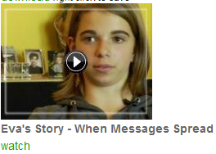
Eva’s Story
Show video by clicking the link: http://www.commonsensemedia.org/educators/lesson/oops-i-broadcast-it-internet-6-8
Scroll down and click watch:
Notes:
SHOW one of the following videos linked to slides 6 & 7, “Eva’s Story –When Messages Spread” or “Brittney’s Story –Posting Something You Regret.”
TELL students that the video is about a real girl who shared something online that she later regretted.
Students will share their responses through the discussion guide and then break in to small groups to review the two case studies provided.
If you show Eva’s Story, divide students up in to small groups and alternate between Case Study 1: Emma’s Secret Crush Goes Viral or Case Study 2: My Secret Diary…Sort Of
*Each discussion guide has a teacher version—see full lesson plan
If you show Brittany’s Story, divide students up in to small groups and alternate between Case Study 1: Emma’s Secret Crush Goes Viral or Case Study 2: My Secret Diary…Sort Of

Slide 7
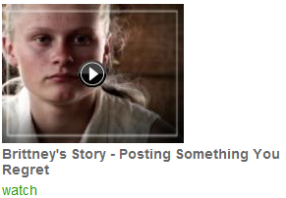
Brittany’s Story
Show video by clicking the link:
http://www.commonsensemedia.org/educators/lesson/oops-i-broadcast-it-internet-6-8
Scroll down and click watch:
Notes:
SHOW one of the following videos linked to slides 6 & 7, “Eva’s Story –When Messages Spread” or “Brittney’s Story –Posting Something You Regret.”
TELL students that the video is about a real girl who shared something online that she later regretted.
Students will share their responses through the discussion guide and then break in to small groups to review the two case studies provided.
If you show Eva’s Story, divide students up in to small groups and alternate between Case Study 1: Emma’s Secret Crush Goes Viral or Case Study 2: My Secret Diary…Sort Of
*Each discussion guide has a teacher version—see full lesson plan
If you show Brittany’s Story, divide students up in to small groups and alternate between Case Study 1: Emma’s Secret Crush Goes Viral or Case Study 2: My Secret Diary…Sort Of

Slide 8
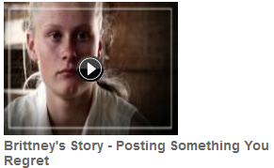
Discussion Review
Did you view…
Notes:
Lead students in the review of their answers from the video you chose to share. Then have students share their discussions based on their small group case study questions. Using the teacher version of the questions with suggested answers from the completelessonplan you will be able to prompt your students and facilitate the discussion.

Slide 9
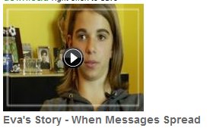
Discussion Review
Did you view…
Notes:
Lead students in the review of their answers from the video you chose to share. Then have students share their discussions based on their small group case study questions. Using the teacher version of the questions with suggested answers from the completelessonplan you will be able to prompt your students and facilitate the discussion.

Slide 10

What do you know?
True or false: If you send a text message, you can control what happens to the message after you send it.
a) True
b) False
Notes:
The next several slides contain questions from the assessment provided in the lesson plan. You may choose to print/copy it for your students or have them answer orally using the PowerPoint slideshow.

Slide 11
What do you know?
Which of the following is an example of over-sharing online?
a) Posting a message on your friend’s wall that says you dislike your basketball coach
b) Posting a photo of you playing basketball
c) Inviting your friends and family to your next basketball game by email

Slide 12
What do you know?
Which of the following is an example of over-sharing online?
a) Posting a message on your friend’s wall that says you dislike your basketball coach
b) Posting a photo of you playing basketball
c) Inviting your friends and family to your next basketball game by email

Slide 13
Wrap up…
What are some examples of people sharing in a rewarding way?
Notes:
Sample responses:
Create and share online photo albums with friends and family. Produce multimedia works like music, videos, or mash-ups. Email or video chat with friends who have moved away or with family that live elsewhere.

Slide 14
Wrap up…
What things can you do to minimize oversharing in your own life?
Notes:
Sample responses:
Don’t share secrets, embarrassing stories, or damaging information about self or others. Make mash-ups or remixes and share them online. Set privacy controls.Thoughtfully manage a positive digital footprint.

Slide 15

Wrap up…
How can you create a positive digital footprint?
Notes:
Answers will vary. Students should acknowledge the importance of thinking ahead before posting online. Will they be proud of the things they share in 5 years? What about in 15 years?

